Slide 1
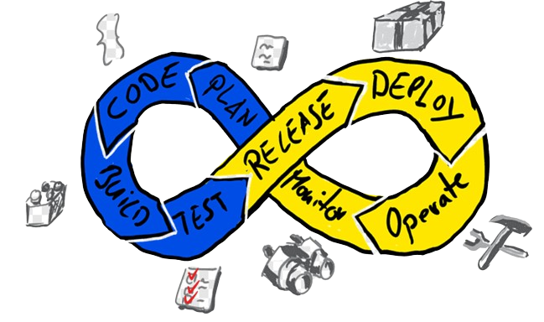
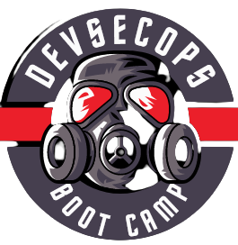
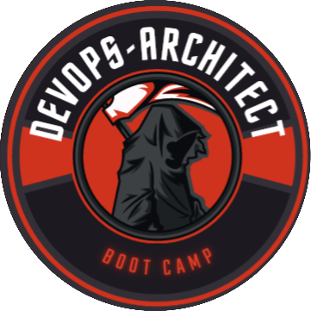
Certified DevOps Professional - Outline
Learn with Bilal : https://www.youtube.com/@bilalmazhar100
GitHub : https://github.com/BilalMaz/DevOps-Architect-BootCamp

Slide 2

About me
Hi there, my name is Bilal, and I will Welcome you to DevOps boot camp! I am thrilled to have you join us for this exciting journey of learning and discovery.
In this boot camp, we will be exploring the principles and practices of DevOps, which is a set of methodologies and tools that aims to bridge the gap between software development and operations. DevOps is an increasingly important area in the field of software engineering, as it helps organizations to streamline their processes, improve their agility, and deliver better value to their customers.
By the end of this boot camp, you will have gained a comprehensive understanding of DevOps and its key concepts, as well as practical skills in areas such as infrastructure automation, continuous integration and delivery, monitoring and logging, and more. You will be equipped with the knowledge and tools to apply DevOps principles in your own work and contribute to the success of your organization.
I am always looking to connect with other professionals in the field, share ideas and insights, and stay up to date on the latest trends and developments. I welcome the opportunity to connect with you and explore ways in which we can collaborate and support each other.
GitHub : https://github.com/BilalMaz/DevOps-Architect-BootCamp
LinkedIn : https://www.linkedin.com/in/bilalmazhar-cyber-security-consultant/

Slide 3
Objective
Equip participants with hands-on expertise in essential DevOps tools and technologies, fostering the practical application of DevOps principles. Through real-world projects, attendees will gain proficiency in automating workflows, configuring cloud environments, implementing CI/CD pipelines, mastering containerization, orchestrating with Kubernetes, and employing Infrastructure as Code (IaC) using Terraform.
The training ensures participants are well-prepared for the "Certified DevOps Professional" certification, combining theoretical knowledge with practical skills for success in diverse DevOps scenarios.

Slide 4
Methodology
Method of the Lectures:
Interactive Lectures: Engaging and informative lectures provide a solid theoretical foundation, ensuring participants understand key concepts and principles ,
Hands-On Labs: Extensive hands-on labs allow participants to apply theoretical knowledge in real-world scenarios, reinforcing practical skills and building confidence ,
Project-Based Learning: Structured projects at each stage of the DevOps lifecycle enable participants to build and deploy applications, reinforcing skills in a simulated work environment,
Case Studies: Real-world case studies expose participants to practical challenges and solutions, enhancing their problem-solving abilities within the context of DevOps practices.

Slide 5
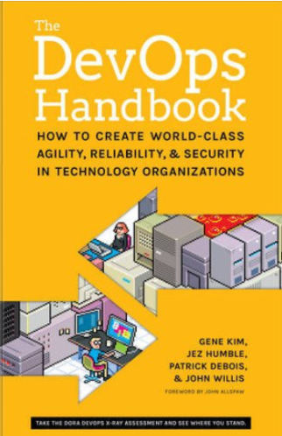
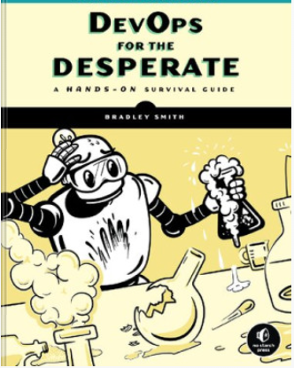
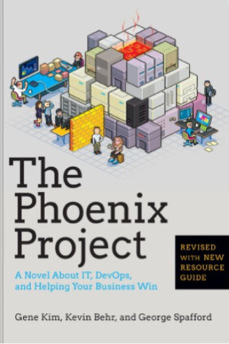
Recomendation & Refrence Books
Notes:
https://singlelogin.re/book/21038927/ff8749/devops-for-the-desperate-a-handson-survival-guide-early-access.html
https://singlelogin.re/book/2492502/9523f5/the-phoenix-project-a-novel-about-it-devops-and-helping-your-business-win.html

Slide 6
Training chapters
Chapter 1 : Introduction to DevOps ,
Chapter 2 : Lab Setup ,
Chapter 3 : Building the Basics ,
Chapter 4 : Introdcution to Linux (Ubuntu ),
Chapter 5 : Introduction to Scripting ( Bash , Python & Go ) ,
Chapter 6 : CI / CD ( Jenkins ) ,
Chapter 7 : Infratruture as a code ( Ansible ) ,
Chapter 8 : Containerization ( Docker ) ,
Chapter 9 : Orechtration ( Kubernetes ) ,
Chapter 10 : Cloud DevOps ( AWS ) ,

Slide 7
Chapter 1 : Introduction to DevOps ,
Topics
Definition and Evolution of DevOps ,
Key DevOps Principles ,
DevOps Lifecycle ,
Benefits of DevOps ,
DevOps Practices ,
DevOps Tools ,
Collaboration and Communication ,
Culture and DevOps Adoption ,
Security in DevOps ,
Future Trends in DevOps

Slide 8
Chapter 2 : Lab Setup
Topics
Installation of Vmware & VirtualBox ,
Virtual Machine Deployment ( Linux ),
Installations
Jenkins ,
Docker ,
Kubernetes ,
Git & Github ,
Python, Go & IDE ( Intigrated Development Enviroment ) ,
Ansible & Terrform ,

Slide 9
Chapter 3 : Building the Basics
Topics
Basic Understanding of Software Development ,
Fundamental Knowledge of IT Infrastructure ,
Command-Line Interface (CLI) ,
Understanding of Operating Systems ,
Basic Networking Concepts ,
Problem-Solving Skills ,
System Design Concepts

Slide 10
Chapter 4 : Introdcution to Linux (Ubuntu ),
Topics
Introduction to Linux ,
Installation of Linux ,
Directory Structure ,
Basic Cammands ,
Administration Task ,
Linux Projects ,

Slide 11
Chapter 5 : Introduction to Scripting ( Bash , Python & Go ) ,
Topics
Installation of IDE ( Python & Go ) ,
Programming Concepts ,
Variables ,
Loops ,
Functions ,
Input handling ,
Swtiching statements ,
Comments , etc

Slide 12
Chapter 6 : CI / CD ( Jenkins )
Topics
Inroduction to CI / CD ,
Jenkins instalation ,
Jenkins Jobs ,
Build Triggers ,
Source Code Management (SCM) Integration ,
Build Tools Integration ,
Artifact Management ,
Continuous Integration (CI) Pipelines ,
Automated Testing with Jenkins ,
Jenkins Plugins ,
Security in Jenkins

Slide 13
Chapter 7 : Infratruture as a code ( Ansible ) ,
Topics
Introduction to IaC ,
Ansible Installation ,
Ansible Architecture ,
Ansible Workflow ,
Ansible Playbooks ,
Host configurations ,
AdHoc Cammands ,

Slide 14
Chapter 8 : Containerization ( Docker ) ,
Topics
Introduction to Continarizations ,
Difference between Container & Virtual Machine ,
Introducion to Docker ,
Installation of Docker ,
Docker hub ,
Docker cammands ,
Docker architecture ,
Docker Projects

Slide 15
Chapter 9 : Orechtration ( Kubernetes ) ,
Topics
Introduction to Orchestration ,
Introduction to Kubernetes ,
Installation of kubernetes ,
Kubenetes architecture ,
Kubernetes cammands ,
Kuberntes congiurations ( POD , Namesspaces , repulica - set , volume & secretes etc )
Application Deployment ,

Slide 16
Chapter 10 : Cloud DevOps ( AWS ) ,
Topics
Introduction to Cloud ,
AWS basics ,
Introduction to AWS DevOps ,
AWS CloudFormation ,
AWS CodeCommit ,
AWS CodeBuild ,
AWS CodeDeploy ,
AWS CodePipeline ,
AWS Elastic Beanstalk ,
Amazon ECS (Elastic Container Service) ,
AWS Integration with CI/CD Tools

